Slide 1
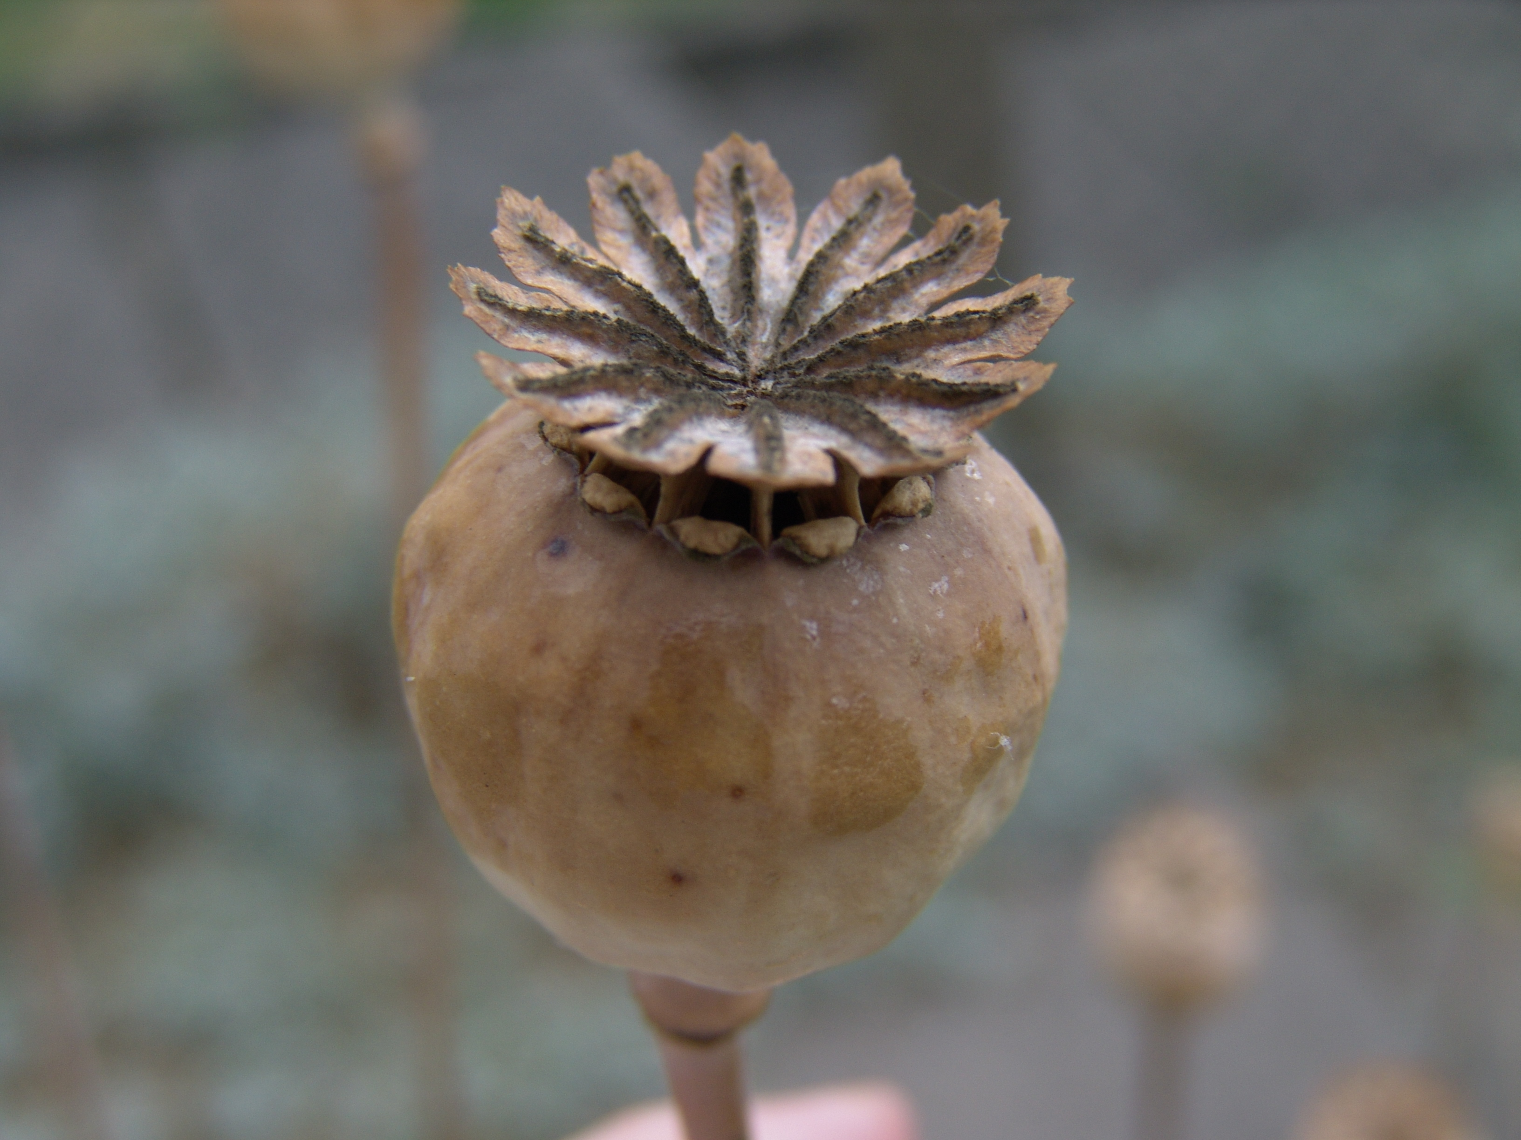
STLN Summer Work Elementary June 29-30
Candi Rumsey, KDE/OVEC
Christine Duke, KDE
Tom Tretter, University of Louisville
Nikkol Bauer, Henry County Schools

Slide 2
Today's Targets As a result of today's learning, I will:
Reflect on best practices in ELA/math integration with science
Deepen my understanding of Question Formulating Technique
Deepen my understanding of science and engineering practices

Slide 3
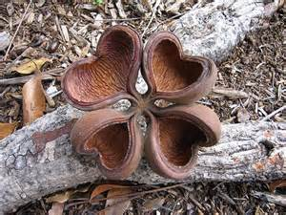
Agenda
8:30-45 Good Morning Into and Overview (Christine)
8:45-9:10 Experience QFT (Candi)
9:10-30 Plan and Conduct an Investigation/Construct an Argument- (Nikkol/ Tom)
9:30-10 QFT Process (Candi)
Take Break as needed
10-11:30 Investigations/ Craft arguments ( Nikkol/TomTL)
11:30-12 Share Arguments (Christine/TL)
LUNCH
12:45-1:15 GRC and Canned Lab Comparison (Nikkol/Tom)
1:15-2:15 ELA Standards in Science (Christine)
2:15-3:00 Work Session Prep (Tom/All)
3:00 Revisit Ideal Integration/Closure (Candi/All)

Slide 4
What does literacy and math integration look like in ideal science instruction?
Think about the question and individually brainstorm.
Jot down your thoughts on the blue index card
Put aside for later

Slide 5
KEY COMPONENTS OF THE QUESTION FORMULATION TECHNIQUE™
1. A Question Focus (QFocus)
2. The Rules for Producing Questions
3. Producing Questions
4. Categorizing Questions
5. Prioritizing Questions
6. Next Steps
7. Reflection

Slide 6
Seed Success

Slide 7
Seed Success

Slide 8
Seed Success

Slide 9
Seed Success

Slide 10
Seed Success

Slide 11
The Rules for Producing Questions
Ask as many questions as you can
Do not stop to discuss, judge, or answer any questions
Write down every question exactly as it is stated
Change any statement into a question

Slide 12
Purpose:
Plan and conduct your investigation
Gather Data
Construct an argument to answer your question

Slide 13
Plan and Conduct an Investigation
http://www.nextgenscience.org/sites/ngss/files/Appendix%20F%20%20Science%20and%20Engineering%20Practices%20in%20the%20NGSS%20-%20FINAL%20060513.pdf

Slide 14
Research question:
Claim:
Evidence:
Justification of the evidence:

Slide 15
Formative Assessment
Lens for what sorts of texts they will search for (how it connects to claim)
Potential claim can answer question
Reason/purpose for investigation that would support the claim
Evaluation of the quality of the evidence to be generated
Multiple sources of evidence

Slide 16
What Would You Do? Let’s Share…..
How would you get your students ready to do QFT?
What would your Qfocus be?

Slide 18
Revisit and Reflect !! What Next??
Bring lesson idea to flip.
Review with others and decide on resources needed tomorrow to develop this lesson.

Slide 19
