Slide 1
Science Network
Meeting
February 27, 2014
Welcome!
Please make sure you pick up one copy of each handout from the table before we begin
Notes:
Science—and therefore science education—is central to the lives of all Americans, preparing them to be informed citizens in a democracy and knowledgeable consumers. It is also the case that if the nation is to compete and lead in the global economy and if American students are to be able to pursue expanding employment opportunities in science-related fields, all students must all have a solid K–12 science education that prepares them for college and careers

Slide 2
Team Norms- Learning Forward

Slide 3
Goals for the day
Reflect on/plan ahead for district leadership
Engage in instructional tasks for ESS1.C and analyze their alignment to targets/standards
Explore appropriate methods/types of assessment for target categories
Explore appropriate formative/summative assessments of targets
Determine evidence of highly effective instruction using CHETL/Framework

Slide 4
Network Vision
“Every school district in the Commonwealth of Kentucky has a knowledgeable and cohesive leadership team that guides the professional learning and practice of all administrators, teachers, and staff so that every student experiences highly effective teaching, learning, and assessment practices in every classroom, every day.”

Slide 5
Building Capacity Around the 4 Pillars

Slide 6
The Four Pillars of the content networks
Standards
Educational Leadership
Assessment Literacy
Characteristics of Highly Effective Teaching and Learning (CHETL)

Slide 7
Continuous formative assessment & virtual parking lot
http://padlet.com/wall/OVECSTLN0214

Slide 8
Follow up from January evaluations

Slide 9
Follow up from January evaluations
What suggestions do you have for the next meeting’s agenda?

Slide 10
Follow up from January evaluations
What questions/concerns do you still have?

Slide 11
Instructional Tasks
Elementary, Middle, High groups
Rotate in sequence
Anchor task—feedback on learning targets

Slide 12
Why learning targets?
If TEACHERS don’t explicitly know what the standards require students to learn, how can they intentionally plan for them to learn it?
If TEACHERS don’t explicitly know what the standards require students to learn, how can they design assessments to tell them if their students are learning it?
If STUDENTS don’t know what they are supposed to learn, how can they tell they are making progress toward learning it?

Slide 13
Attributes of Clear Targets
Learning targets (are): …as opposed to:
Accomplished in a few days at most
Long term
Specific to the what and how (clear indication of desired performance or knowledge; it is apparent to the teacher and learner when it has been accomplished)
Global and somewhat ambiguous (May be without criteria for successful achievement/expected behaviors) OR of such a large ‘grain size’ that it requires achieving multiple, scaffolded targets to attain
Usually consist of a concept (noun), skill (verb) and often a specified context.
Lacking one or more of the components

Slide 14
Learning targets (are): …as opposed to:
Teachable/learnable using a variety of instructional activities/strategies/contexts/tools.
A single approach or activity is the only approach possible with the given target; not transferrable to another context
One component in a sequence of scaffolded accomplishments
Focused on what is to be LEARNED
Only focused on what is to be DONE (activity)

Slide 15
The ultimate evaluation criteria for learning targets:
“If my students can successfully meet all of these individual targets, will they have met the full intent of the standard?”

Slide 16
Lunch

Slide 17
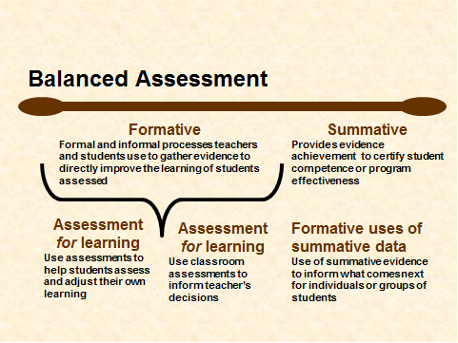
Notes:
Begin with a Review of Balanced Assessment Literacy
Address Learning Target: Articulate the importance of a balanced assessment system in planning, implementing and assessing the new science standards.

Slide 18
Key Characteristics of Assessment Literacy
Key 1
Clear Purpose
Key 2
Clear Targets
Key 3
Sound Design
Key 4
Effective Communication
Key 5
Student Involvement
Notes:
The first discussion round refers to the 5 Key Characteristics of Assessment Literacy. (Text page 5). All of the pieces contributing to sound classroom assessment instruments and practices are built on a foundation of the following five keys to quality. Key 1 They have a clear purpose…they are designed to serve the specific information needs of intended uses. Key 2 they are based on clearly articulated and appropriate achievement targets, Key 3…accurately measure student achievement, Key 4…yield results that are effectively communicated to users, and Key 5 involves the student in self-assessment, goal setting, tracking, reflecting on and sharing their learning)

Slide 19
Key 3: Sound Assessment Design
Select a proper method
Select or create quality items, tasks, and rubrics
Sample appropriately
Prevent bias
Design assessments so students can self-assess and set goals based on the results
Notes:
Slide 40
“High-quality assessments are not built first and then retro-fitted into a context. After we have established the purpose and identified the learning targets to be assessed, then we are ready to (read slide).”

Slide 20
Possible Assessment Methods
Selected Response
Multiple Choice
True/False
Matching
Fill in
Extended Written Response
Performance Assessment
Personal Communication
Questions
Conferences
Interviews
Notes:
Slide 41
“The assessment methods available to us fall into one of four categories: (read slide). The methods are not interchangeable; some fit some contexts but not others. No method is inherently superior to the others. All are viable choices, depending on two variables: purpose—Who will use the information? What decisions will it inform? and target—What kind of learning do you want to assess?”

Slide 21
Classroom Assessment Strategies
Selected Response
Constructed
Response
Performance Assessment
Observations/
Conversations
Multiple Choice
True-False
Matching
Diagram
Fill-in-the-blank (words, phrases)
Essay
Short answer (sentences, paragraphs)
Web
Concept Map
Flowchart
Graph
Table
Matrix
Illustration
Presentation
Movement
Science lab
Athletic skill
Dramatization
Enactment
Project
Debate
Model
Exhibition
Recital
Performance Task
Oral questioning
Observation
Interview
Conference
Process description
Checklist
Rating scale
Journal sharing
Thinking aloud a process
Student self-assessment
Peer review
Adapted from the work of Dr. Robert Marzano

Slide 22
Classroom Assessment Strategies
Selected Response
Constructed
Response
Performance Assessment
Observations/
Conversations
Multiple Choice
True-False
Matching
Diagram
Fill-in-the-blank (words, phrases)
Essay
Short answer (sentences, paragraphs)
Web
Concept Map
Flowchart
Graph
Table
Matrix
Illustration
Presentation
Movement
Science lab
Athletic skill
Dramatization
Enactment
Project
Debate
Model
Exhibition
Recital
Performance Task
Oral questioning
Observation
Interview
Conference
Process description
Checklist
Rating scale
Journal sharing
Thinking aloud a process
Student self-assessment
Peer review
Adapted from the work of Dr. Robert Marzano

Slide 23
Classroom Assessment Strategies
Selected Response
Constructed
Response
Performance Assessment
Observations/
Conversations
Multiple Choice
True-False
Matching
Diagram
Fill-in-the-blank (words, phrases)
Essay
Short answer (sentences, paragraphs)
Web
Concept Map
Flowchart
Graph
Table
Matrix
Illustration
Presentation
Movement
Science lab
Athletic skill
Dramatization
Enactment
Project
Debate
Model
Exhibition
Recital
Performance Task
Oral questioning
Observation
Interview
Conference
Process description
Checklist
Rating scale
Journal sharing
Thinking aloud a process
Student self-assessment
Peer review
Adapted from the work of Dr. Robert Marzano

Slide 24
Classroom Assessment Strategies
Selected Response
Constructed
Response
Performance Assessment
Observations/
Conversations
Multiple Choice
True-False
Matching
Diagram
Fill-in-the-blank (words, phrases)
Essay
Short answer (sentences, paragraphs)
Web
Concept Map
Flowchart
Graph
Table
Matrix
Illustration
Presentation
Movement
Science lab
Athletic skill
Dramatization
Enactment
Project
Debate
Model
Exhibition
Recital
Performance Task
Oral questioning
Observation
Interview
Conference
Process description
Checklist
Rating scale
Journal sharing
Thinking aloud a process
Student self-assessment
Peer review
Adapted from the work of Dr. Robert Marzano

Slide 25
Classroom Assessment Strategies
Selected Response
Constructed
Response
Performance Assessment
Observations/
Conversations
Multiple Choice
True-False
Matching
Diagram
Fill-in-the-blank (words, phrases)
Essay
Short answer (sentences, paragraphs)
Web
Concept Map
Flowchart
Graph
Table
Matrix
Illustration
Presentation
Movement
Science lab
Athletic skill
Dramatization
Enactment
Project
Debate
Model
Exhibition
Recital
Performance Task
Oral questioning
Observation
Interview
Conference
Process description
Checklist
Rating scale
Journal sharing
Thinking aloud a process
Student self-assessment
Peer review
Adapted from the work of Dr. Robert Marzano

Slide 26
So now what?
Types of learning targets
What learning targets assess
Types of assessment methods
Matching the most appropriate method of assessment with each type of learning target…

Slide 27
Target/Method Match

Slide 28
Target/Method Match
Target | Selected Response | Extended Written Response | Performance Assessment | Observation/ Conversation
Knowledge | Yes! | Yes-Understandings of relationships among elements of knowledge | Nope- too time consuming | Maybe (question, evaluate answers, infer mastery –but time consuming

Slide 29
Target/Method Match
Target | Selected Response | Extended Written Response | Performance Assessment | Observation/ Conversation
Product | No | Maybe-if product is written | Yes! | No

Slide 30
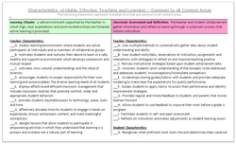
CHETL
Domain 1: Planning & Preparation
Domain 2: Classroom Environment
Domain 3: Instruction
Domain 4: Professional Responsibilities
Domain 5: Student Growth
Notes:
Reminder – The Framework for Teaching provides us a common language for describing teacher effectiveness . . . (next slide)

Slide 31
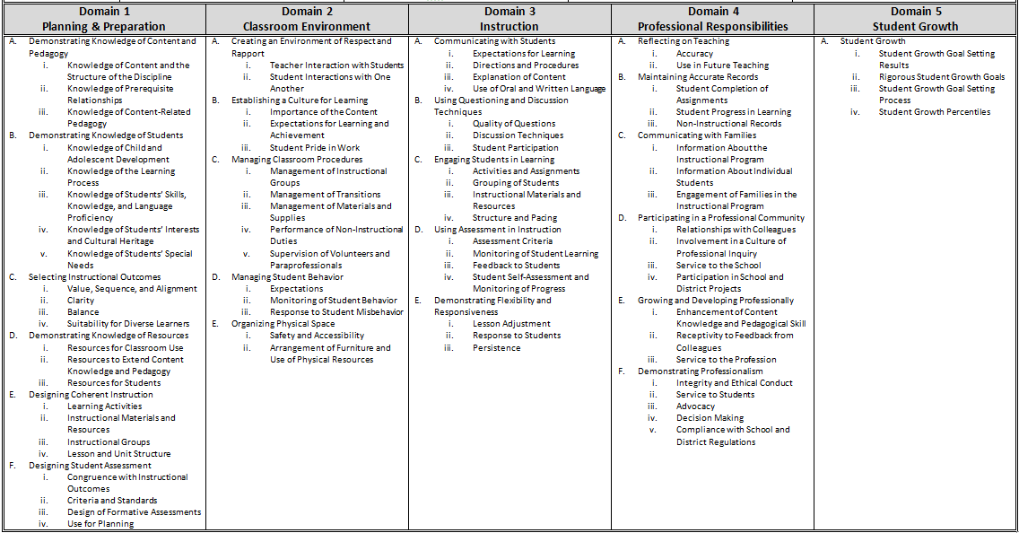
Overview of the Framework for Teaching

Slide 32
CHETL
Section 1
Learning Climate (D, I)
Section 2
Classroom Assessment and Reflection (A, B, C, D, I, J)
Section 3
Instructional Rigor and Student Engagement (B, I, G, H)
Section 5
Knowledge of Content (E)

Slide 33
3 A Communicating With Students
3B Questioning and Discussion Techniques
3C Engaging Students in Learning
3D Using Assessment
3E Demonstrating Flexibility and Responsiveness
Evidence:
Ineffective | Developing | Accomplished | Exemplary
Notes:
With (same grade level) partners, evaluate the learning task designed for your grade level. Give evidence from the task to defend your answer.

Slide 34
Based on the evidence collected…
What suggestions would you make to enhance the learning task?

Slide 35
Meeting dates
March 27 (Gheens Foundation Lodge,
1421 Beckley Creek Parkway, Louisville)
Possible summer dates:
July 10, 11
July 14, 15
July 17, 18

Slide 36
Follow up
KEDC target review?
Be thinking about assessment design

