Slide 1

Leadership
Pick one of the leadership quotes from this morning’s slide show that
  Resonates with you and be prepared to share why.
      OR
  Made you think about your role as a Teacher Leader. Be ready to share.

Slide 2

















Learning
Teaching
Enhancing
Supporting
Sharing
STLN
March 29, 2016

Slide 3

Welcome
STLN
March 29, 2016

Slide 4

Today’s Facilitators
Dr. Tom Tretter, University of Louisville
Nikkol Bauer, Henry County
Christine Duke, KDE, Science Consultant
Candi Rumsey, KDE/OVEC,
Instructional Specialist

Slide 5


STLN Site Norms
  Start and end on time
  Cell phones on vibrate
  Rule of two feet
  Calls (phone and nature)
  Respect those sharing.
  Engage-minds on!
  Pick up around your area when we are finished
  Others?

Slide 6

Agenda
Welcome
Our Role as Teacher Leaders
Revisiting the Network
Reflecting on the Network
Professional Learning Groups to look at our student’s work
Lunch
E.P. Sawyer Park Representatives
Am I Headed in the Right Direction?
Reflections
KY Assessment System for Science
Next Steps
Evaluations/Celebrations

Slide 7

Looking Back to Move Ahead
Network Vision
“Every school district in the Commonwealth of Kentucky has a knowledgeable and cohesive leadership team that guides the professional learning and practice of all administrators, teachers, and staff so that every student experiences highly effective teaching, learning, and assessment practices in every classroom, every day.”

Slide 8
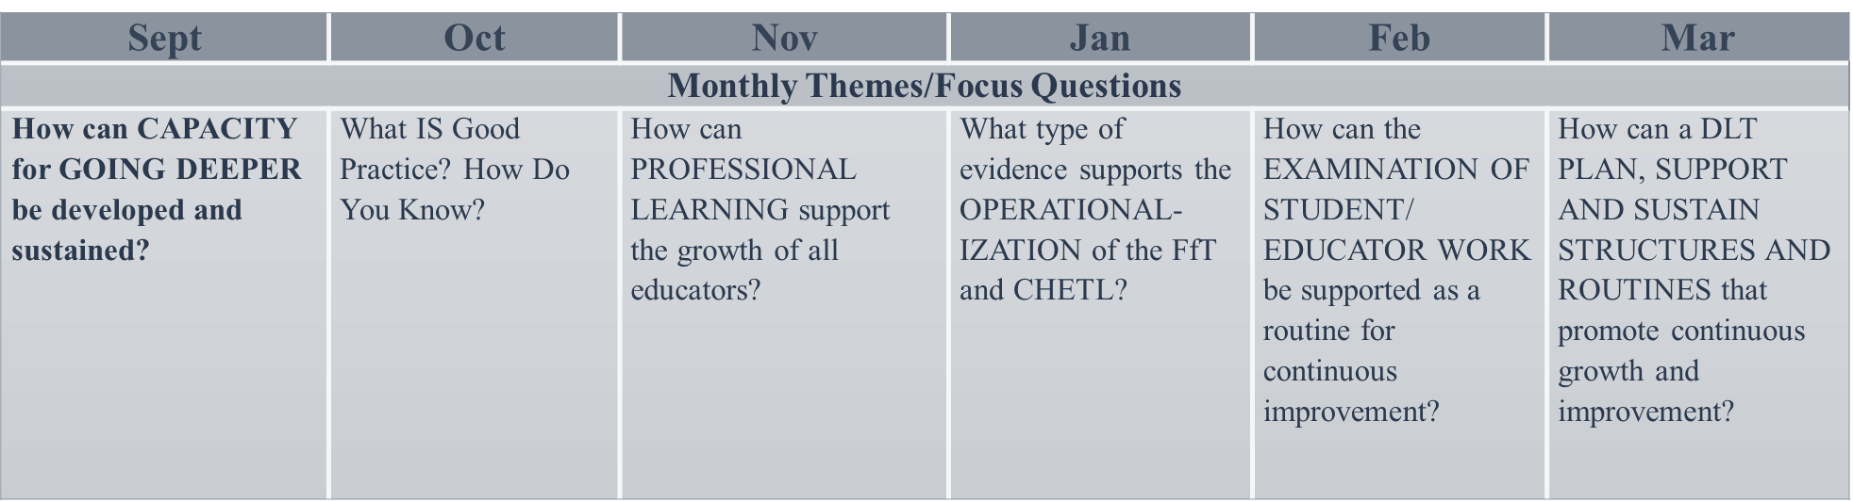
Year at a Glance

Slide 9


THEME of the DAY
Systems of Continuous Improvement
Reference the two systems reflection prompts throughout the day.

Slide 10
Four Pillars of Our Work
Characteristics of Highly Effective Teaching and Learning
Assessment Literacy
Kentucky’s Core Academic Standards
Leadership

Slide 11

Roles and Responsibilities of a Network Participant
Revisit your role and responsibilities by
completing the graphic at the bottom.

Slide 12


Slide 13


The Standards
Generate talking points you can use as a leader in your districts about important aspects of implementation of the NGSS.
Integrated 3-Dimensional instruction

Slide 14
The Standards
What does it means to understand and implement the standards?
1. As a table create 4-7 Index cards with one idea per card about important things for understanding the standards.
2. Walk and Wander- find similar ideas and form a cluster.
3. After discussing, create a one-
sentence statement on strips to share out.
.

Slide 15

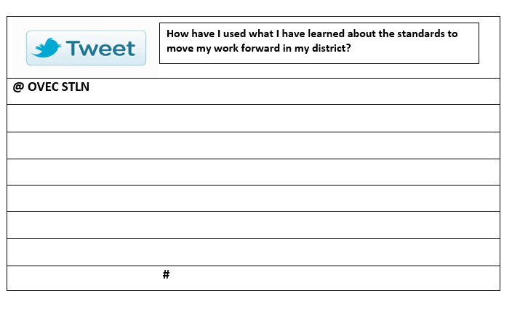
Think & Tweet

Slide 16

10 Minute
BREAK

Slide 17
Instruction & Assessment
What features of instruction & assessment would you expect to observe in a strong NGSS classroom?
What are some key look-fors when observing an NGSS classroom?
As a table group generate 4-7 Index cards with one idea per card.
Monkey in the Middle– One person in middle reads card. If you have the same look-for, form a group.
Another person stands in the middle and reads card. This continues until all groups are formed.
After discussing, create a one-sentence statement on strips to share out.
Centered around a Phenomenon

Slide 18
Analysis of Student Work
Start with the numbered list of “features of good NGSS instruction & assessment”.
2. Individually: Notate on your scenario/task/student work that you brought where you find EXPLICIT EVIDENCE of the numbered feature.
3. Repeat for each numbered feature.
4. Pairs: Share with partners. Partners should serve as critical friends by asking questions, probing for information, and pushing back, if necessary.

Slide 19

http://tinyurl.com/kyNGSStoolbox
What tools and resources are in your professional toolbox?
Notes:
To post url on chartpaper rather than spend time now…

Slide 20
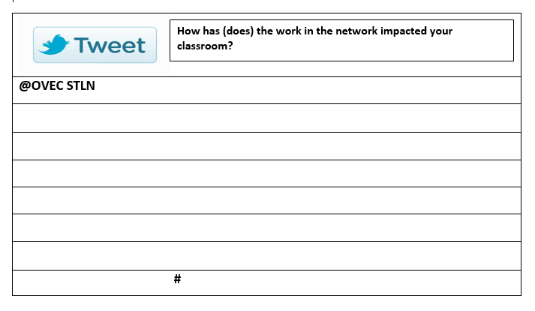
Think & Tweet

Slide 21


Enjoy the Cake!!

Slide 22

Science in the Field
Lora Sekeres
Nick Price

Slide 23
Am I Heading in the Right Direction?
Group Share Out
Strengths
Areas of Growth
Next Steps
Needs

Slide 24
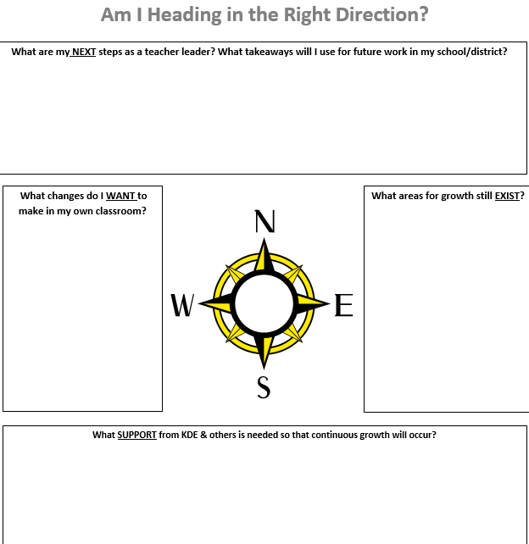

Slide 25
SYSTEM

Slide 26
Systems as a Crosscutting Concept
Read pages 91-92 of the Framework (in handouts as well)
Brainstorm important aspects/constructs for systems-thinking.

Slide 27

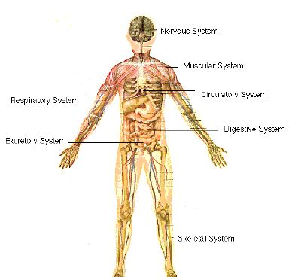
Notes:
Point out components listed

Slide 28
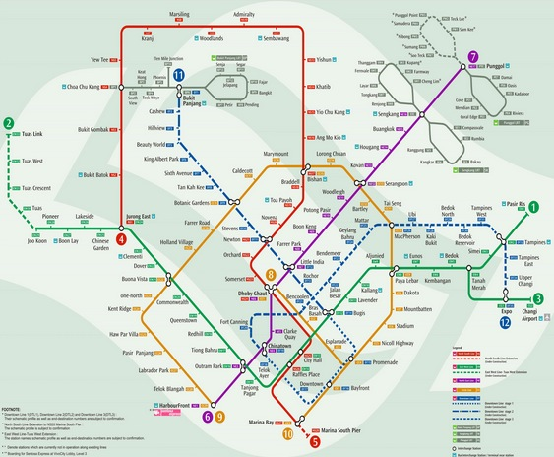

City Transit System
Home Security System
Notes:
Point out components listed

Slide 29
Science Assessment System
Classroom Embedded Assessments
Through Course Tasks
State Summative Assessments

Slide 30
Science Assessment System
Create a representation of KY Assessment System incorporating the following ideas from Frameworks on XCC systems:
Components,
Interactions,
Boundaries,
Flows In and Out,
Independent Subsystems,
Mutual Interdependence,
Limitations

Slide 31
Gallery Walk
Give feedback with sticky notes

Slide 32
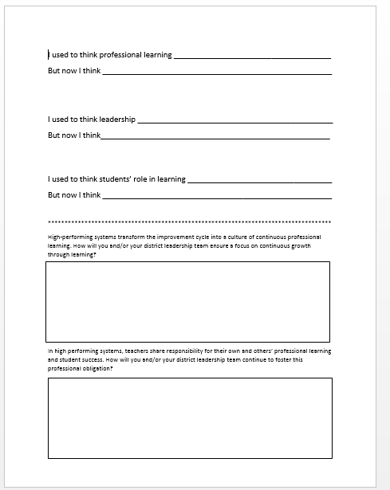
FINAL REFLECTION

Slide 33

DRAFT KENTUCKY SCIENCE ASSESSMENT SYSTEM

Slide 34
What?
Take time to read over the
Draft New Science Assessment System.
10-15 minutes
Annotate
Pay particular attention to your role in the system

Slide 35
So What?
What do we already have in place in preparation for this balanced assessment system?
Reflect over the work from the last three years of the Science Content Network. How has this work and other initiatives implemented in your school/district changed classroom practice to support the new Science Assessment System?

Slide 36
Now What?
Next Steps
Discuss next steps with your district team.
What will be your first priority to be prepared for the Science Assessment System?
How will your team support ALL teachers in Assessment Literacy?

Slide 37

MOONSHOT THINKING

Slide 38

Moonshot Thinking
Speed Share:
1. Identify a practice or strategy that is really working for me and my students
2. How and what I am currently learning as a professional.

Slide 39
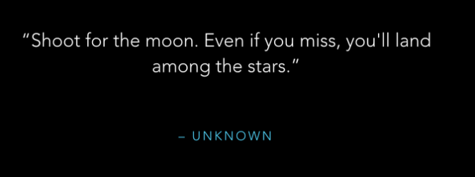
Celebration

Slide 40


Slide 41

Please Complete Evaluation
Thank You!

Slide 42
Opportunities
Newport Aquarium
Environmental Education

