Slide 1
OVEC/JCPS/KSB science network
February 29, 2016

Slide 2







Welcome!

Slide 3

Today’s Facilitators
Dr. Tom Tretter, University of Louisville
Nikkol Bauer, Henry County
Christine Duke, KDE, Science Consultant
Mindy Curless, KDE, STEM Consultant
Candi Rumsey, KDE/OVEC,
Science Instructional Specialist

Slide 4

Agenda
Welcome
Our role as Teacher leader
Looking at the Work of Colleagues
Revisiting Phenomena
Lunch
Congruency
CER Argumentation Structure
Work Time for Tasks
Next Steps
Homework
Evaluations

Slide 5

TARGET
How can the EXAMINATION OF STUDENT/EDUCATOR WORK be supported as a routine for continuous improvement?

Slide 6
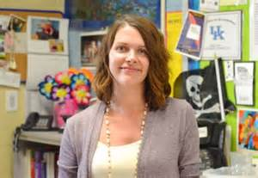
Something to Think About
Your Role as a Teacher leader
Please read the article I emailed to you this morning while we are waiting to begin.
http://www.courier-journal.com/story/opinion/2016/02/26/new-professionalism-teachers/80849692/

Slide 7

Let’s Reflect
What has been most helpful for you? What do you need to do to continue to promote increased understanding in your district?

Slide 8
Work time
Collaboratively Interpret, Create, Implement & Assess to Increase Student & Professional Learning

Slide 9

http://tinyurl.com/kyNGSStoolbox
What tools and resources are in your professional toolbox?
Notes:
To post url on chartpaper rather than spend time now…

Slide 10

Taking a Closer Look
Work with a partner
Trade tasks and student work
Document evidence using tools of your choice
Complete the feedback sheet to return to the teacher
Turn in tasks and student work

Slide 11

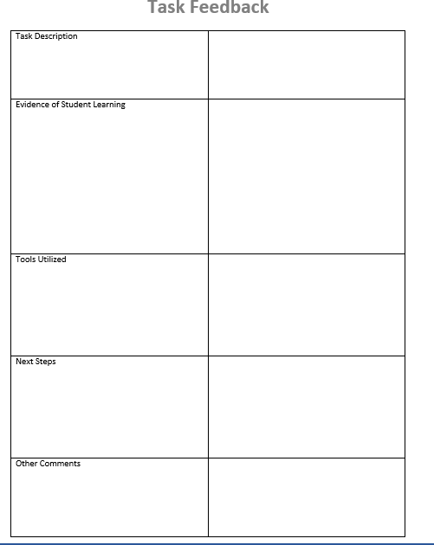

Slide 12
Puzzling phenomena
Shifting from learning about it to figuring it out
Notes:
Talk about fundamental phenomena that is imbedded in each PE? Now, what connections can you make to the fundamental phenomenon that is relevant to your grade level?
https://www.teachingchannel.org/blog/ausl/2014/09/22/transitioning-to-the-ngss-tips-and-resources-for-planning-science-units-around-puzzling-phenomena/

Slide 13
Compelling or not?
That is the Question
How do constellations move across the sky?
How did ancient cultures use objects in the sky to know when to plant crops?
How can a bucket of water cool down a hot room in the desert?
Does an empty balloon and a full balloon weigh the same?

Slide 14
Puzzling Phenomena
Read the blog post by Alyssa Berg from Teaching Channel.
As you read:
  Be ready to share one word, phrase
  and sentence that resonated with
  you as you read.
Take turns sharing your words, phrases, and sentences. Do not discuss them until everyone has shared!
WORD
PHRASE
SENTENCE

Slide 15
Puzzling Phenomena
How did your thinking change about phenomena after reading the blog post?
  I used to think ____________ but now I know __________ is important when anchoring units with phenomena.

Slide 16

Think, Write, Pair, Share
What is a task?
What makes a task a high quality task?

Slide 17
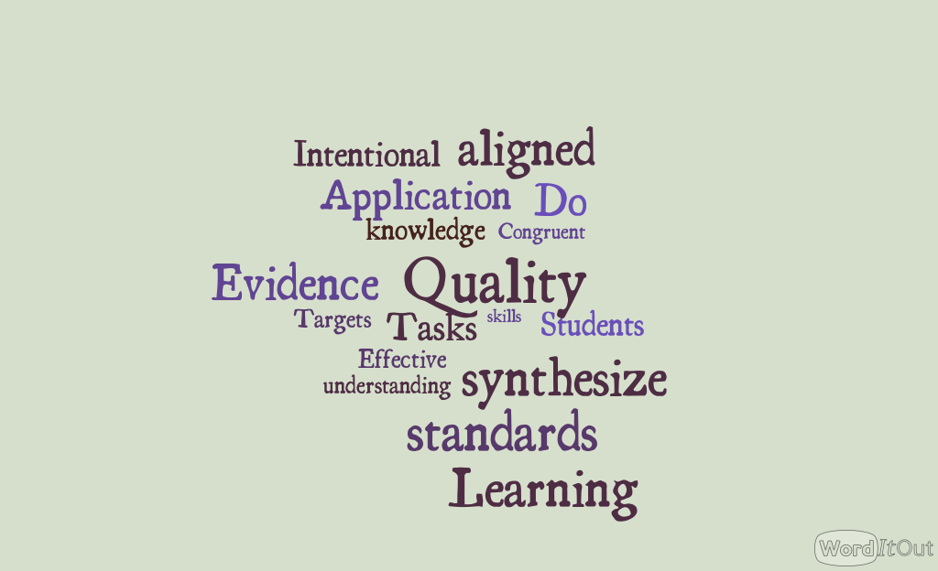
Notes:
Not sure if I will use this

Slide 18
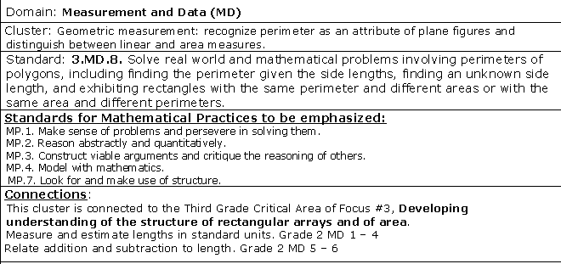
Mrs. Brown’s class will raise rabbits for their spring science fair. They have 24 feet of fencing with which to build a rectangular rabbit pen to keep rabbits.
• If Ms. Brown’s students want their rabbits to have as much room as possible how long would each of the sides of the pen be?
• How long would each of the sides of the pen be if they had only 16 feet of fencing?
• How would you go about determining the pen with the most room for any amount of fencing? Organize your work so that someone else who reads it will understand it.
RIGOR
CONTENT

Slide 19
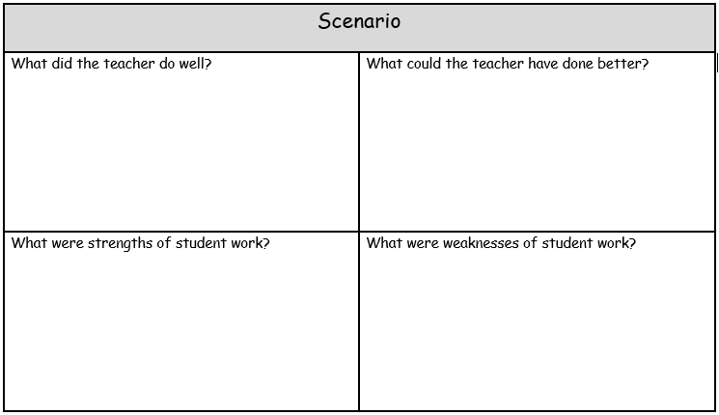
The Rabbit Task

Slide 20

Find the letter (A, B, C, D) from the center of your table.
Take your scenario recording sheet with you to your poster that matches your letter.
You will have 5 minutes at each station to read the scenario and record your thoughts.
You will rotate clockwise when the timer goes off.
STUDENT WORK
FACILITATION
RIGOR
CONTENT
Notes:
Have someone write the definition of congruency on the board as we review and add ideas.
20

Slide 21
Debriefing the Scenarios
Notes:
Close this thinking/learning opportunity with a wrap around discussion - small group then large group (always nice to chart responses to allow participants hear and see – and reflect)
Which of these is the most likely culprit impeding congruency in your school? And what evidence tells you this?
How does this discussion or this learning relate to student engagement and opportunity for demonstration of learning?
As you are facilitating this learning experience model the 5 strategies for formative assessment where possible.
In Dylan Wiliam’s book Embedded Formative Assessment, he provides 5 strategies that he has come to believe through his 35 years of experience and research, are core to successful formative assessment practice in the classroom:
1. Clarifying, sharing, and understanding learning intentions and criteria for success – getting the students to really understand what their classroom experience will be and how their success will be measured.
2. Engineering effective classroom discussions, activities, and learning tasks that elicit evidence of learning – developing effective classroom instructional strategies that allow for the measurement of success.
3. Providing feedback that moves learning forward – working with students to provide them the information they need to better understand problems and solutions.
4. Activating learners as instructional resources for one another – getting students involved with each other in discussions and working groups can help improve student learning.
5. Activating learners as owners of their own learning – We wrote a recent blog on this topic: self-regulation of learning leads to student performance improvement. - See more at: https://www.nwea.org/blog/2012/dylan-wiliam-the-5-formative-assessment-strategies-to-improve-student-learning/#sthash.j4R1pucu.dpuf

Slide 22
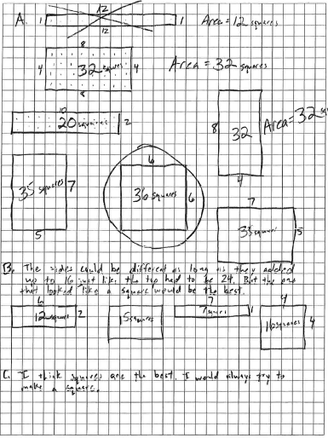
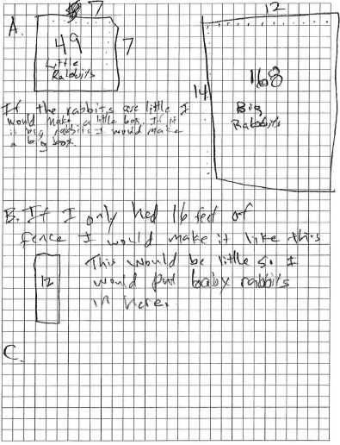
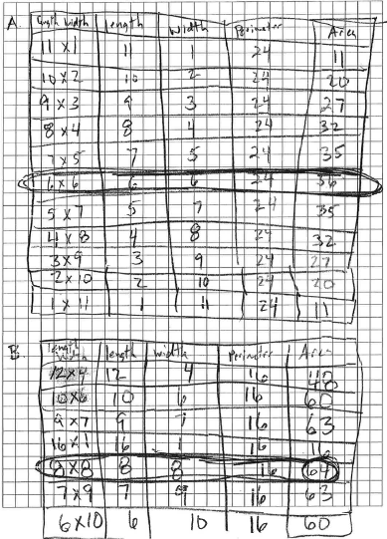
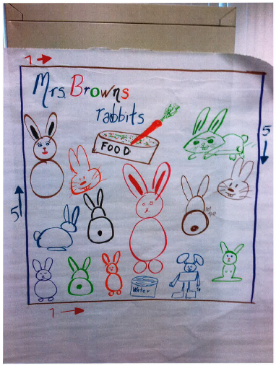
The Rabbit Task
A | B | C | D

Slide 23
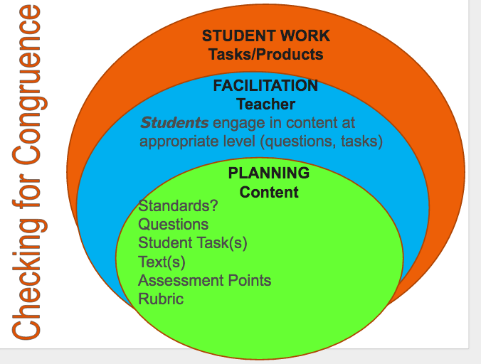

Slide 24

When you plan…

Slide 26
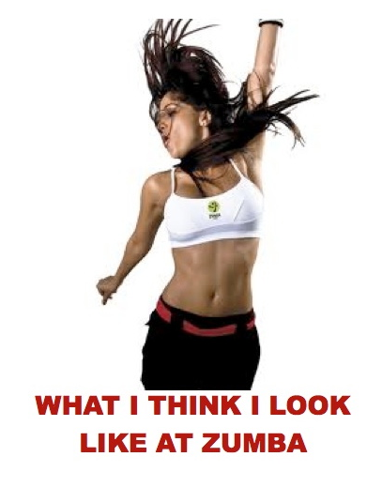

Slide 27
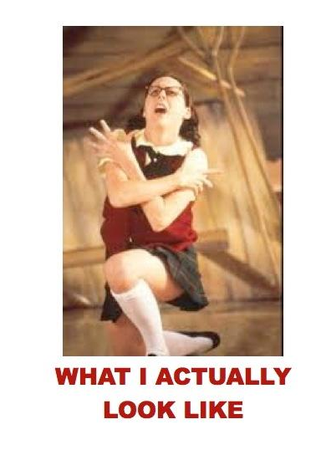

Slide 28
What resources do you have to help ensure quality of tasks?
Notes:
Then consider
What resources do you have to help ensure congruence?
Content Network teachers
Effective teachers in your building or district
Professional Learning groups/content area learning groups in your building
Instructional Rounds
KCAS
Observations

Slide 29


Slide 30
Students can demonstrate their learning best when the teacher…
Read the article
Classroom Assignments Fail to Meet Common-Core's Higher Bar, Study Says – edweek By Liana Heitin
Are you over-scaffolding ?
Discuss at your table and share out

Slide 31
https://www.ted.com/talks/dan_meyer_math_curriculum_makeover?language=en
TED TALK

Slide 32
Research question: What is the most effective way to generate valid evidence of student learning?
Claim:
Evidence:
Justification of the evidence:

Slide 33
Work time
First, work with your partner to discuss the phenomenon you chose last month.
  Does it need to be tweaked?
  Is it written as a compelling question?
  Work on your task for next time

Slide 34
PLC
Professional learning communities

Slide 35
What makes a plc a Professional learning community?
Take a moment to think about a community or network of educators in which you were involved that truly helped you grow professionally.
What were the characteristics of that PLC? Be ready to share.
Does a PLC need to be formed by administrators to be effective?

Slide 36
Professional learning
Step 1: Discuss
  What does your PLC need moving forward?
  What resources/protocols can you utilize?
Step 2: Collaborate
  With your district, create a PLC Priority Plan for February – June
  Identify district, school, and teacher leaders involved
  Organize your plan in phases (estimated starting and ending dates)
  Identify necessary protocols/resources
Step 3: Reflect
  Are your PLC priority plans vertically aligned within your district? What help do you need from your administrators?
  How can you collaborate to build capacity within your PLC?
Step 4: Take Action
  Continue to refine and implement your plan
Notes:
Ryan

Slide 37

To Do for Next Time
Bring your task with a description of instructional context and flow
Bring student work samples
Remember these are possible examples of
Through Course Tasks
Notes:
Plan for between now and February meeting
TL will have doc that shows plan and to do list prior to next meeting

Slide 38

Please complete a sticky note and put on the poster.
How does this connect to prior learning?
How can I use this to impact my classroom practice?
How can I use this to impact my district?

Slide 39

Please Complete Evaluation
Thank You!

