Slide 1

Something to Think About

Slide 2




Welcome
STLN
November 30, 2015

Slide 3

Agenda
Welcome
Norms
PL Vs PD
Break
PL Plan
Dr. Pruitt speaks to us
Lunch 11:15-12
Hour of Code
Task analysis practice
Collaboration on task analysis &
revision
Evaluations
Take Aways /Homework
&

Slide 4

Norms of Collaboration
1. Pausing
2. Paraphrasing
3. Posing
Questions
4. Putting Ideas on
the Table
5. Providing Data
6. Paying Attention
to Self and Others
7. Presuming
Positive Intentions
© Center for Adaptive Schools

Slide 5
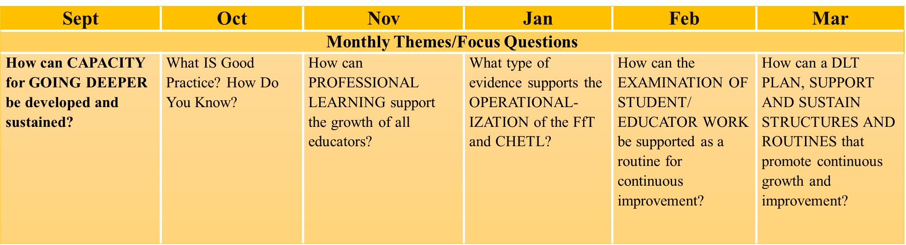
Year at a Glance

Slide 6
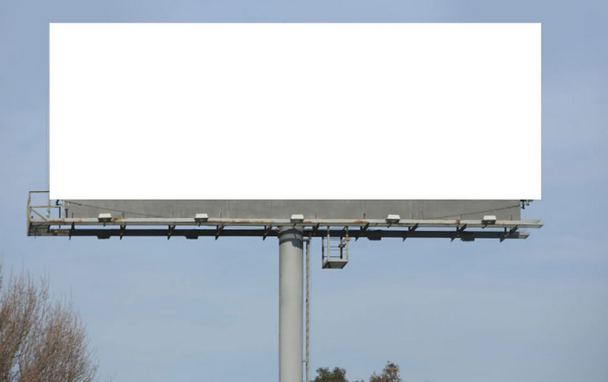
Big Messages
Re-evaluate a structure/system for educators to learn together and communicate learning.
How can professional learning support the growth of all educators?
Planning Professional Learning (PL) that includes analyzing information & data to identify needs.

Slide 7

ANY QUESTIONS or CONCERNS?
Parking Lot

Slide 8

https://vimeo.com/33234646

Slide 9
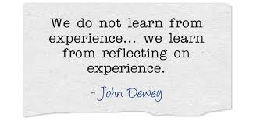
Let’s take time to reflect.
Notes:
We want to give you a few moments to reflect on what you heard from Dr. Pruitt. See reflection handout with some guiding questions. Take a moment to note your own thoughts then share at your table.

Slide 10
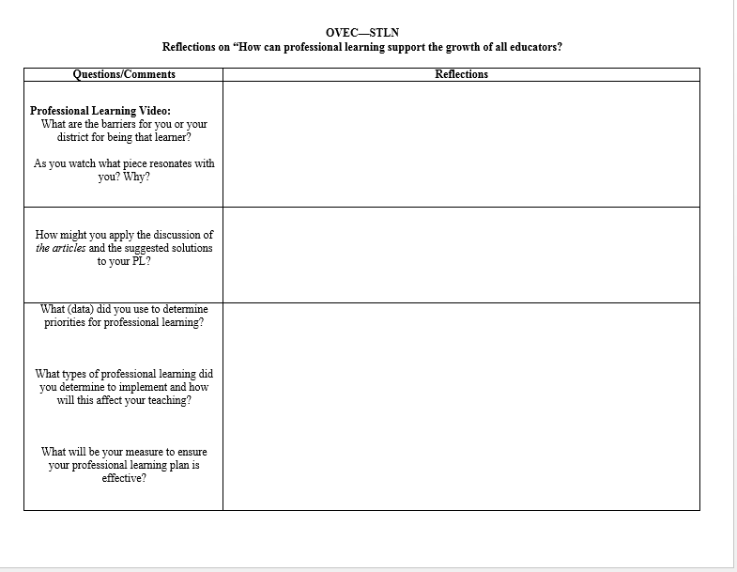

Slide 11

Professional Development or Professional Learning?
In your journals write down each meeting, conference, book study, course, etc. in the past year that you would consider professional learning or professional development.

Slide 12

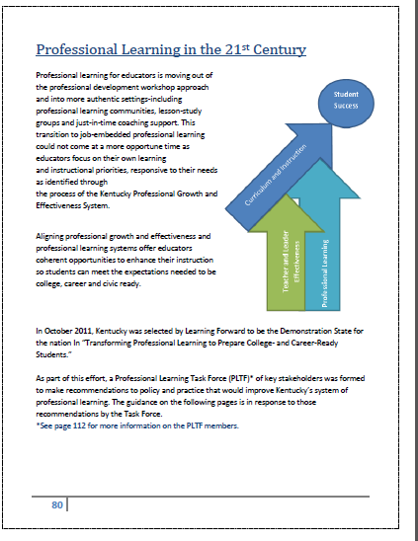

Slide 13
Professional Learning Vs. Professional Development
Individually create a t-chart based on your opinion of what professional learning is vs. professional development
2. Use info from Model Curriculum Framework
3. Discuss with group/synthesize info to create a table t-chart on chart paper (with examples of each provided)

Slide 14



What can we learn from these?

Slide 15

Mind
Professional Development
Professional Learning
Isolated event or occasional episode
Focused on what we are doing on a particular day
Learning a concept to the knowledge or understanding level
Occurs at a conference or training
Continuous process
Analyzing real work practices to consider what occurs in classrooms
Focused on collective set of learning experiences to improve student learning outcomes
http://education.ky.gov/teachers/PD/Pages/default.aspx

Slide 16


Slide 17


Professional Learning Plan
I would like to become more effective at ________
What tells me this is an area of growth is_____(data/evidence). [Where am I?]
I will know I’ve attained this goal/target by/when I ____ (outcome/measure). [Where do I want to go?]
Here is my plan for “closing the gap”: (the ACTIVITIES that will enable the learning)
Attend
Conference___
Read
____
Talk to
_____
Attend
______
Read _______
= Professional DEVELOPMENT;
Inside=supporting learning goal;
Outside=not pushing on goal
PLC
Attend conference ____
Observe and analyze___
Work with___ as a thinking/feedback partner
Participate in
_____
Participate in
_____

Slide 18
Professional Learning Plan
Why do I want/need to engage in this experience?
I would like to become more effective at ________ because _____________.
What tells me this is an area of growth is_____(data/evidence). [Where am I?]
I will know I’ve attained this goal/target by/when I ____ (outcome/measure). [Where do I want to go?]
3. What specific learning goals will this specific learning experience help me accomplish?
1. How can I put myself in the best frame of mind for intentional learning through this experience?
5.What supports can I put in place now to ensure time and support for practice, reflection, and follow-up to this specific learning?
2. What data or information will help me be optimally prepared for this learning experience?
4. What knowledge, practice, skills, or habits do I hope this will make possible?
=To help individuals or teams prepare for a professional learning or learning event-use or adapt for a particular learning experience, whether virtual, face-to-face, short-term or ongoing.
Excerpt from JSC The Learning Forward Journal August 2015, Vol. 36 No. 24 page 8 www.learningforward.org.
Why did Why did I/my team engage in this experience?
I/my team engage in this experience?

Slide 19
Professional Learning Plan
I would like to become more effective at ________ because ____________.
Here is my plan for “closing the gap”: (the ACTIVITIES that will enable the learning)
Attend
Conference___
Read
____
Talk to
_____
Attend
______
Read _______
= Professional DEVELOPMENT;
Inside=supporting learning goal;
Outside=not pushing on goal
PLC
Attend conference ____
Observe and analyze___
Work with___ as a thinking/feedback partner
Participate in
_____
Participate in
_____

Slide 20
How do our PL experiences connect to the goal(s) of our PL plan?

Slide 21
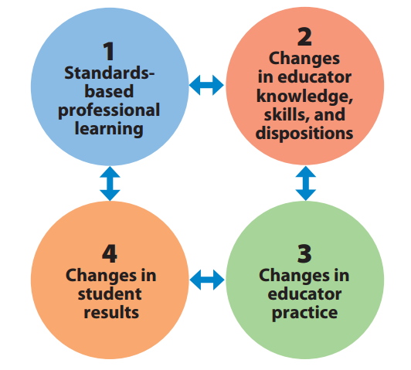
Implementing and Monitoring the PL Plan

Slide 22
PLC Priority Plan Guiding Questions:
What does your PLC need moving forward? What resources/protocols can you utilize? Are the PLC priority plans vertically aligned within your district?
Two lists:
1) within teacher control,
2.) priorities you would like to partner with administration on; help you need from them to succeed
Develop common strands aimed at individual professional development.

Slide 23

What is Good Practice?
Connecting October Network Meeting to Professional Learning
Take a minute to reflect on last month’s network meeting. The theme was “What is Good Practice?” Think of at least one good practice or a tool/resource that reflects good practices that will result in student learning that was shared at the meeting.
Share your thoughts with your table group.
How do those big ideas connect to the Professional Learning Standards and practices we’ve discussed so far?

Slide 24
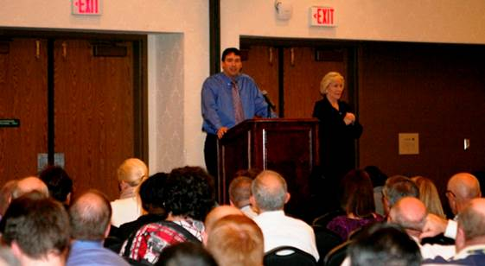
Meet our new commissioner
Dr. Stephen Pruitt
  https://www.youtube.com/watch?v=CqfHEFf8gnQ

Slide 25

11:15-12:00 Enjoy!!

Slide 26


Slide 27

https://hourofcode.com/us
https://www.khanacademy.org/computing/hour-of-code/hour-of-code-for-teachers/a/using-hour-of-code-in-your-classroom
https://hourofcode.com/us/promote/resources#videos

Slide 28

QUESTIONS WHILE LOOKING AT STUDENT WORK:
1) Summarize patterns of responses you’ve noted – create rough “categories” of students, and indicate what next instructional steps each category might need (emphasizes FORMATIVE nature of the assessment)
2) Explicitly identify 3-D assessment information in the formative assessment task (or note what is missing). What is foregrounded? Backgrounded? (emphasizes 3-D assessment)
3) Feedback on the formative assessment task. What seemed to be working well for uncovering student learning? What might benefit from being edited? (emphasizes task analysis process, something they’ll do a lot of with existing stuff ‘out there’ to modify them to be more NGSS 3-D.)

Slide 29
Assessment Task # 1
Create a trifold (one section each for solid, liquid, gas) with two parts: (a) create your own model for each type of matter; (b) write a description of your models.

Slide 31
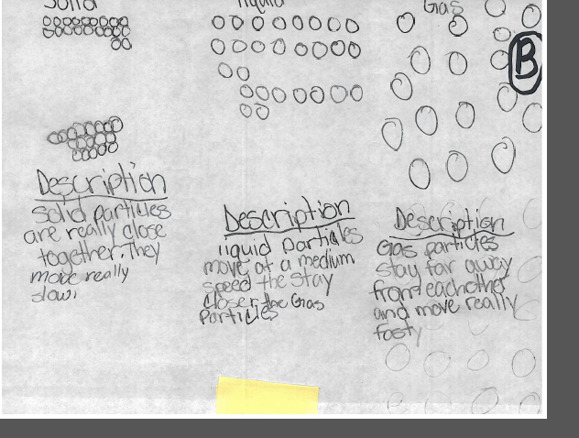

Slide 32
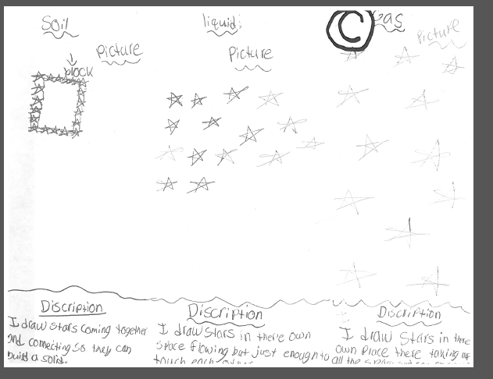

Slide 33
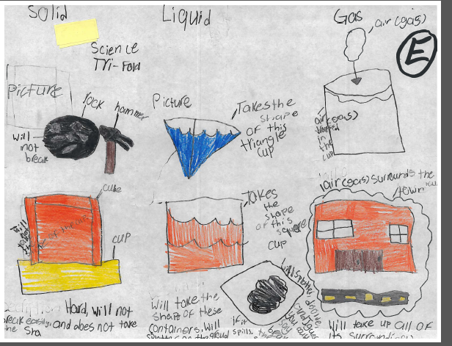

Slide 34
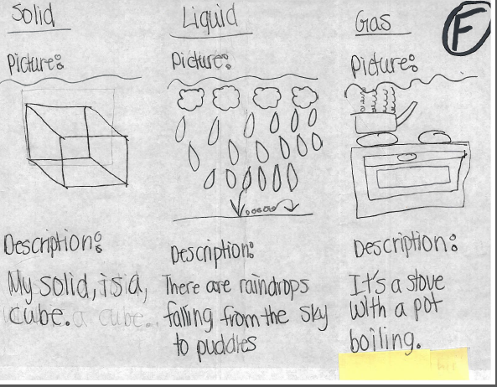

Slide 35
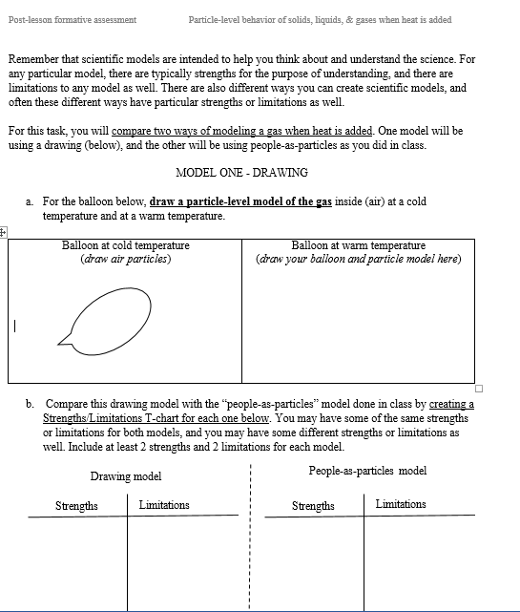
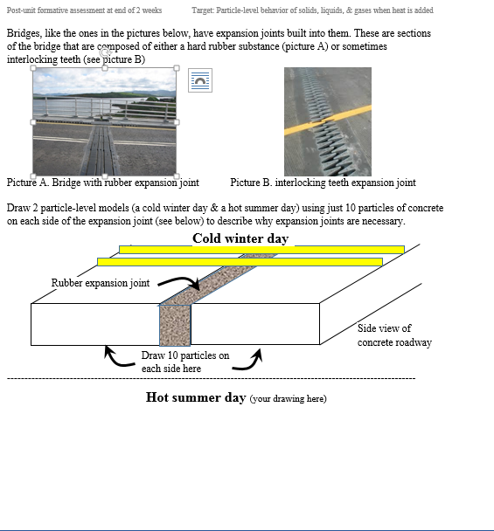
Assessment Task # 2

Slide 36
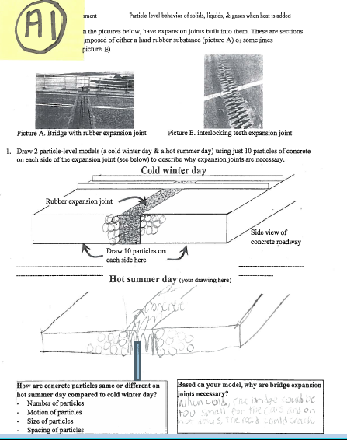
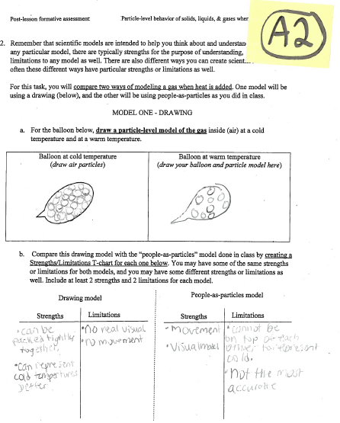

Slide 37
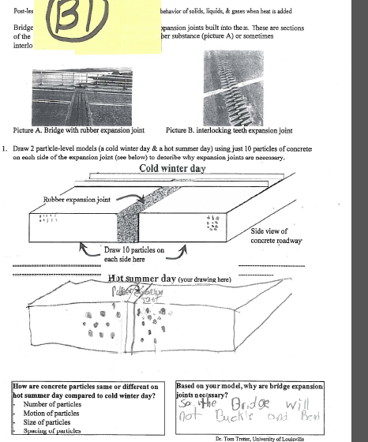
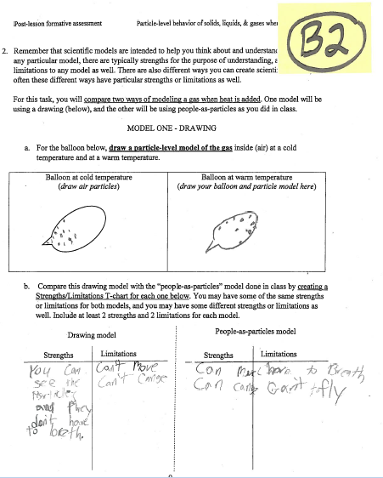

Slide 38
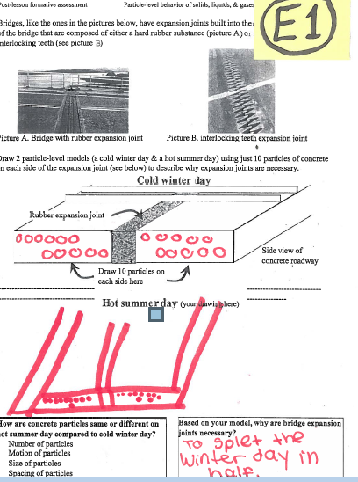
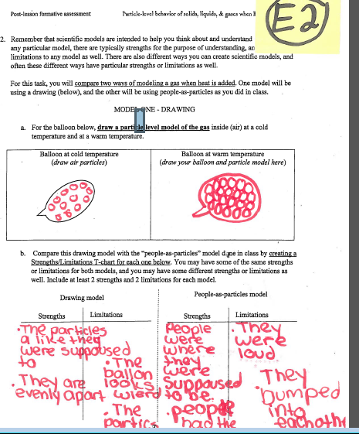

Slide 39
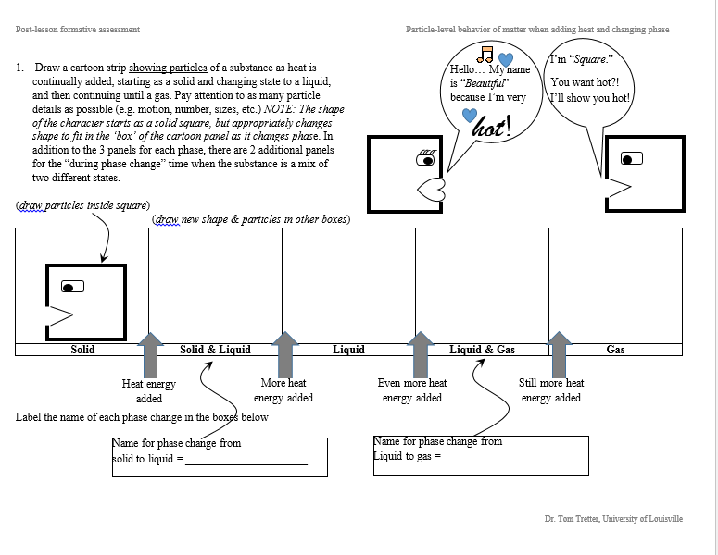
Assessment Task # 3

Slide 40
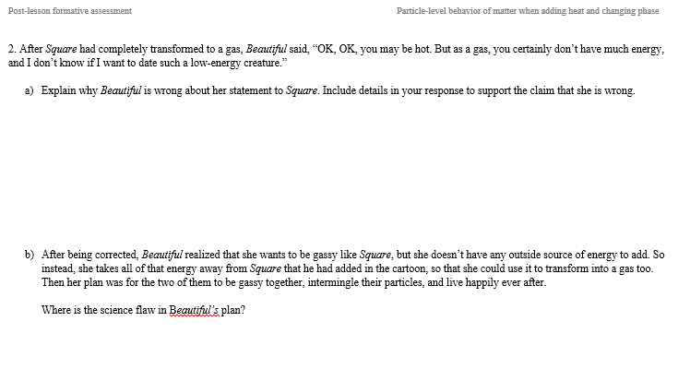

Slide 41

Work in grade band teams and follow the given protocol to analyze tasks.
Revise tasks as needed.

Slide 42
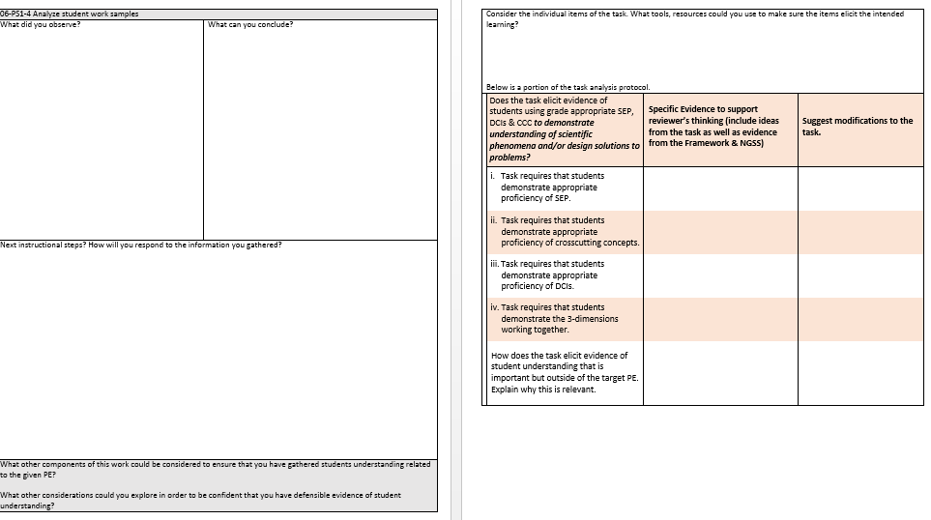
Task Analysis

Slide 43
Classroom Observations
Let me know when you are doing a lesson that I can come and observe
I want to come see you all in action
I can HELP:
if you are teaching something new for the first time
You need a thinking partner
Feedback /Coaching
I would like to be in every district by the end of March

Slide 44

Remember to give us feedback before your leave today.
Please complete the evaluation

Slide 45

Turn in your evaluation
& nametag
To Do Before the next meeting
Have students complete your assessment task
Bring work samples and data to share
January 27, 2016 at the Art Center

