Slide 1
Welcome! We’re glad to see you!
Review the documents on the table and consider why education is important.
Why do we care that all students learn? Who benefits and how do they benefit?
Discuss with your colleagues and be prepared to discuss after we begin today. Identify 2 reasons you feel it’s most important for students to learn.

Slide 2
Science Network Meeting
January 22, 2015

Slide 3
Agenda
Introduction/Norms
Why education?
What affects student learning?
Goal of Inquiry
Argumentation
Reflection
Assessment Item Review
Develop GRC/Argumentation experience

Slide 4
Rights
You have the right to make contributions to an attentive and responsive audience and facilitator.
You have the right to ask questions.
You have the right to have your ideas discussed rather than your personality.
Obligations
You are obligated to speak loudly enough for others to hear.
You are obligated to listen while others are speaking.
You are obligated to agree or disagree (and explain why) to other people’s ideas.
You are obligated to distill information, and make notes regarding how to translate to others.

Slide 5
Keep Moving Forward!
http://youtu.be/7p_eKV3SzwE

Slide 6
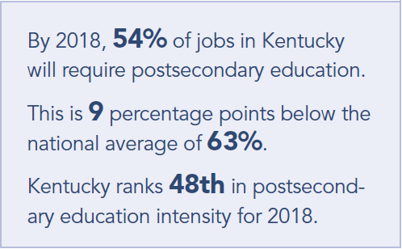
Why does education matter?
What will give us the biggest bang for our buck in improving education?
Class size
School structure
Teacher subject knowledge
Formative assessment
Learning styles

Slide 7
What is Formative Assessment?

Slide 8
Formative Assessment
Students and teachers
Using evidence of learning
To adapt teaching and learning
To meet immediate learning needs
Minute-to-minute and day-by-day
From Content then Process by Dylan Wiliam

Slide 9
5 Strategies of FA
Clarifying learning intentions and sharing criteria for success
Engineering effective classroom discussions, questions, and learning tasks that elicit evidence of learning
Providing feedback that moves learning forward
Activating students as the owners of their own learning
Activating students as instructional resources for one another

Slide 10
Connecting 5 Strategies to PGES

Slide 11
Break

Slide 12
Purpose of the Network
Is | Isn’t
Provide equal representation to all school districts to contribute to setting statewide expectations Build capacity at the district level to understand KCAS Create a PLC of content and administrator leaders Build the capacity of every member to identify and implement highly effective teaching, learning and assessment practices Provide the leadership skills, tools, resources | Disseminate finished products created by others Create an opportunity to merely comply with EILA or PD hour requirements Be out of the school/district for a day to “hear from” KDE Practice a packaged lesson/presentation that is intended to be replicated in every classroom/school (‘train the trainer’ model) Focus on test preparation at the expense of effective instruction

Slide 13
Scientific Inquiry in Schools
Consider for a minute how you might explain scientific inquiry for K-12 students
How does your concept compare to this process?
Asking a question
Devising a means to collect data
Interpreting the data
Formulating a conclusion
What skills would students need to be successful with this approach to inquiry?
Problems with this “skills” approach? Is it because it is “skills based?” Why did “we” go down this path?

Slide 14
What is our goal for student engaging in inquiry?
Construction of an argument or justified explanation – requires reasoned thinking by students
What’s important if that’s the goal?
The QUALITY of argument becomes the focus.
The result is students evaluating and critiquing…
Previous “skills” are developed for different reasons
Genuine engagement!

Slide 15
Turn the page over…
Read the passage….
Underline any “skills that inquiry develops in students” as you read
Argumentation… why is that an effective approach to student learning? Effective for focusing on what’s important for engaging students in “inquiry.”
Inquiry vs. Practices – let’s make sure we can share the understanding of why we arrived at “practices” and consider the implications for other unintended consequences in education.

Slide 16
Argumentation
Read the document
In your group of 4, complete the sentence strip with evidence from the text and your prior experience.
Engaging students in scientific argumentation is effective for student learning because: _________________________________.

Slide 17
Generate an Argument Instructional Model

Slide 18
Components of an Argument

Slide 19
Example of HS Student Argument

Slide 20
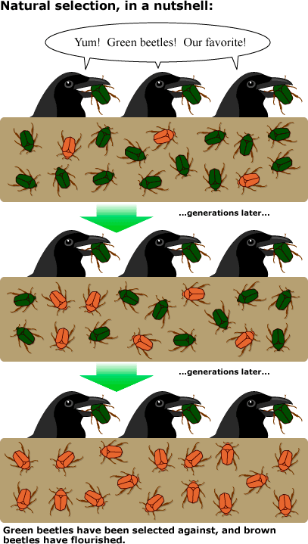
Natural Selection
Image obtained from University of California Museum of Paleontology's Understanding Evolution (http://evolution.berkeley.edu)

Slide 21
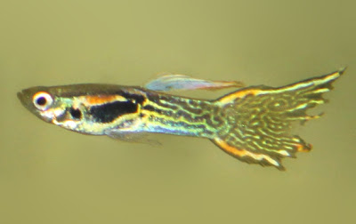
Guppy Color Variation
Construct initial claim in 4 person group (20 min)
Round-robin rotation (10 min)
Informer: stay at table and explains initial claim and reasoning; carefully considers questions posed – no defending the claim at this point.
Travelers: listen to the explanation (all three rotate to the same table) and pose questions for clarity – no telling your group’s ideas
Rotate twice (4 min rotations)
Refine argument with base group (10 min)
Reflective discussion (5-10 min)
Written argument (skip)

Slide 22
Lunch
During lunch, take a moment to submit a person or organization to the Informal Science Educator Hub!

Slide 23
Guppy Debriefing
Brainstorm specific pieces of evidence of student learning in ALL three dimensions
Compare rubric from Biology book with the Success Criteria shared at the beginning
On poster paper, graphically represent how argumentation relates to the 8 SEPs and how it is enhanced by intentional use of the 5 strategies using specific evidence from the guppy experience
Brainstorm topics you teach or data sets to which you could apply the argumentation process

Slide 24
Reflection
Mix-Pair-Share
How will the argumentation experience impact the following:
Your classroom instruction?
Interactions with your colleagues related to implementation of NGSS?
Sharing new learning throughout your district?

Slide 25
Assessment Item Review
What defensible evidence does the item elicit?
Provide evidence that this task is congruent with NGSS at the appropriate depth/grade-level.
Which aspects of each dimensions does the task address?
Plus/Delta – provide an explanation for the good and the parts that need revision
How could grade appropriate language of the SEP or CC be used within the task to better elicit evidence of student learning?

Slide 26
Develop GRC/Argumentation Experience

Slide 28
Wrap-Up and Homework
Assessment design vendor expected to be in place by February and will start attending network meetings
Homework: Implement your lesson idea and bring back evidence of student learning
Next meeting: February 26, 2015 at the OC Arts Center
Evaluation
Go forth and change the world!

