Slide 1
Science Network
Meeting
October 29, 2013
Welcome!
Please make sure you pick up one copy of each handout from the table before we begin
Notes:
Science—and therefore science education—is central to the lives of all Americans, preparing them to be informed citizens in a democracy and knowledgeable consumers. It is also the case that if the nation is to compete and lead in the global economy and if American students are to be able to pursue expanding employment opportunities in science-related fields, all students must all have a solid K–12 science education that prepares them for college and careers

Slide 2
Team Norms- Learning Forward

Slide 3
Goals for the day
Understand how the key characteristics of assessment literacy impact instructional practice and assessment design
Understand how a balanced assessment system connects to PGES
Make connections between the FFT, CHETL for science and NGSS
Summarize the essential components of SEP and illustrate how each progresses across grade levels
Identify examples of NGSS practices in current instruction through the lens of the FFT
Describe the structure and purpose of the Innovation Configuration maps

Slide 4
Network Vision
“Every school district in the Commonwealth of Kentucky has a knowledgeable and cohesive leadership team that guides the professional learning and practice of all administrators, teachers, and staff so that every student experiences highly effective teaching, learning, and assessment practices in every classroom, every day.”

Slide 5
Building Capacity Around the 4 Pillars

Slide 6
The Four Pillars of the content networks
Standards
Educational Leadership
Assessment Literacy
Characteristics of Highly Effective Teaching and Learning (CHETL)

Slide 7
Continuous formative assessment & virtual parking lot
http://padlet.com/wall/OVECSLN1013

Slide 9
Follow up from September evaluation responses
Examples of units
Unit development
Assessment issues
Inclusion

Slide 10
Pillars again
Pillars of Network Meetings
Network Foundations….
Highly Effective Teaching and learning
Kentucky’s Core Academic Standards
Assessment Literacy
Leadership
TPGES –Teacher Professional Growth and Effectiveness System

Slide 11
Take a Few Minutes to Self-Assess…
How would you rate your knowledge of Assessment Literacy?
Exceptional --------------- Progressing---------------------Not Yet

Slide 13
Definition of Classroom Literacy
The knowledge and skills needed to:
Gather accurate information about student achievement.
Use the assessment process and its results effectively to improve achievement.

Slide 14
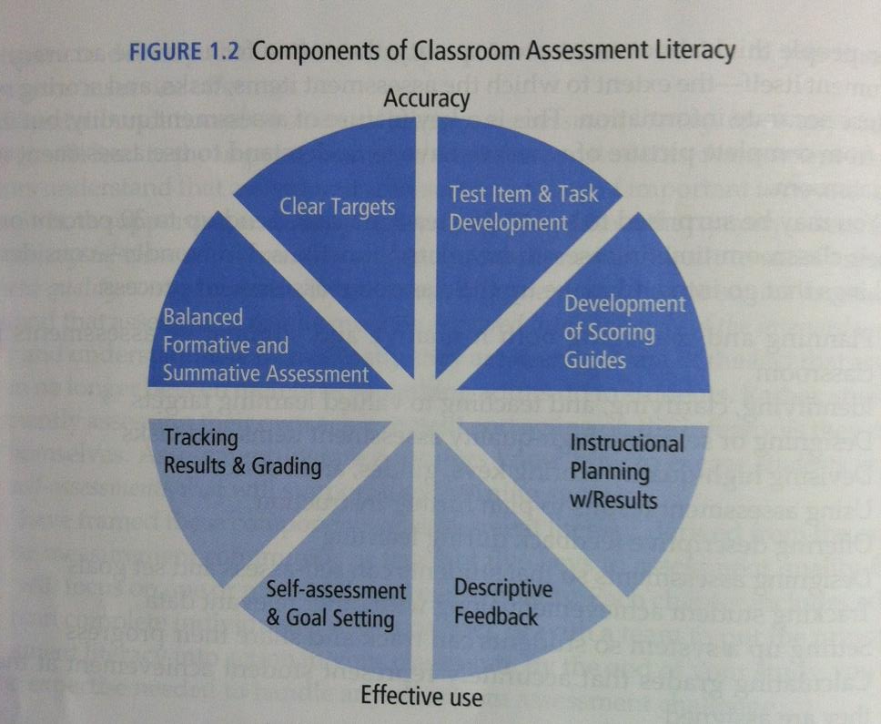

Slide 15
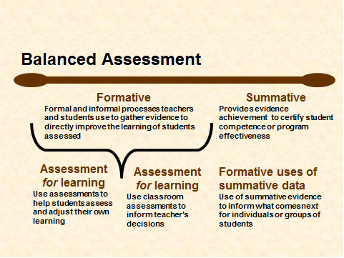
Notes:
Senate Bill 1. In Section 2,
subsection h, it states: The Dept of Ed shall provide or facilitate statewide training sessions for existing teachers and administrators on how to:
1. Integrate the revised content standards into classroom instruction;
2. Better integrate PERFORMANCE ASSESSMENT OF STUDENT WITHIN THEIR INSTRUCTIONAL PRACTICES
3. Help all students use higher-order thinking and communication skills.
In section 3, subsection a, it states: The KBE shall be responsible for creating and implementing a BALANCED statewide assessment program that measures the students’, schools’, and districts’ achievement of the goals set forth in KRS 158.645 and 158.6451…
While the OAA works toward the SUMMATIVE components, we are obligated to assist teachers, schools, and districts with the FORMATIVE—what TEACHERS and SCHOOLS and DISTRICTS can do/create to allow them to ensure students are on-track with key targets/standards each and every day…which has FAR MORE POTENTIAL TO INCREASE STUDENT SUCCESS AND ACHIEVEMENT THAN A SINGLE END OF YEAR MEASURE.

Slide 16
Key Characteristics of Assessment Literacy
Key 1
Clear Purpose
Key 2
Clear Targets
Key 3
Sound Design
Key 4
Effective Communication
Key 5
Student Involvement

Slide 17
Quote Cafe
Read and Think Deeply about your Quote
At Your Table…Discuss your thinking. Explain how this idea impacts instructional practice.
Quote Exchange…Find a Partner (with a different quote), explain your thinking, discuss how your quote impacts instructional practice.
Exchange…Repeat

Slide 18
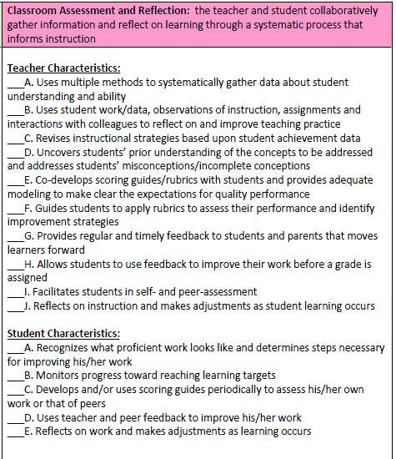
Assessment Literacy - CHETL

Slide 19
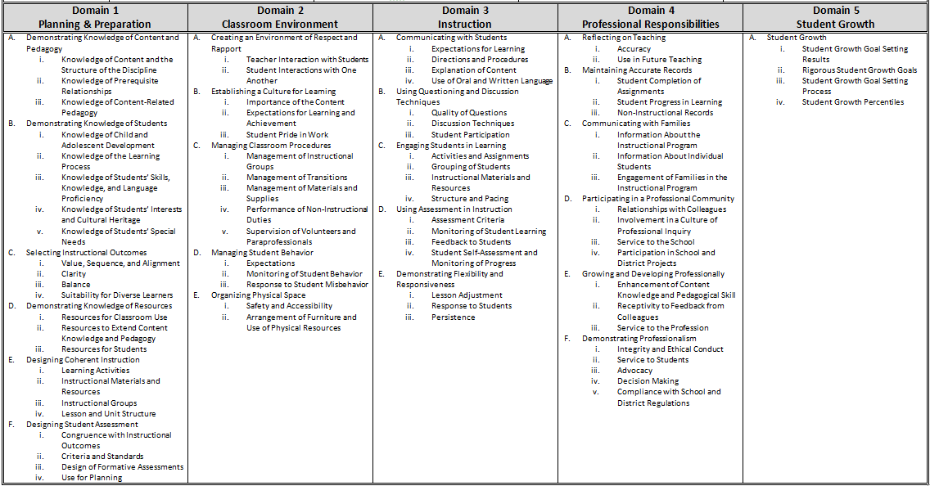
Overview of the Framework for Teaching

Slide 20
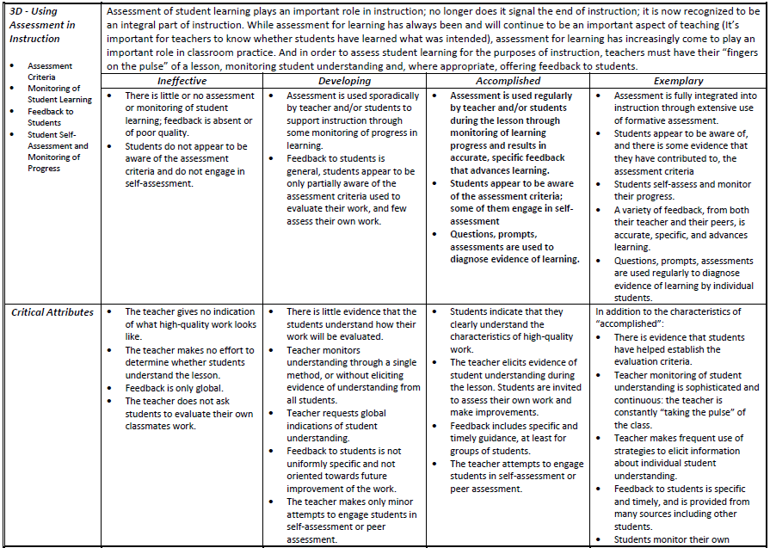
3D – Using Assessment in Instruction

Slide 21
Using CHETL, FfT, and Your Knowledge of Balanced Assessment, discuss…
Why is Assessment Literacy important?
How does Assessment Literacy impact our instructional practice? What does this look like in my classroom?
How does Assessment Design connect with TPGES?
Notes:
SB1 section 1 part 1 subsection b state: Schools SHALL develop their students’ ability to
1. USE basic communication and mathematics skills for purposes and situations they will encounter throughout their lives;
2. APPLY core concepts and principles from mathematics, the sciences, the arts, the humanities, social studies, and practical living studies TO SITUATIONS THEY WILL ENCOUNTER THROUGHOUT THEIR LIVES;
3. Become self-sufficient individuals of good character exhibiting the qualities of altruism, citizenship, courtesy, hard work, honest, human worth, justice, knowledge, patriotism, respect, responsibility, and self-discipline;
4. Become responsible members of a family, work group, or community, including demonstrating effectiveness in community service;
5. THINK and SOLVE problems in school situations and in a variety of situations they will encounter in life;
6. CONNECT and INTEGRATE experiences and new knowledge from all subject matter fields with what they have previously learned and build on past learning experiences to acquire new information through various media sources; and
7. EXPRESS their creative talents and interests in visual arts, music, dance and dramatic arts.
(NO single end of year/end of course assessment can do that…it may be ONE part—but it cannot do it all…AND THAT IS WHAT WE WANT TO SUPPORT—that is where the BALANCE comes in!)

Slide 22
For Next Time Read Chapters 1-3 Prepare Discussion Questions

Slide 23
Chapter 1—What are the benefits of building assessment instruments and practices on a foundation of the five keys to quality classroom assessment?
Chapter 2—Of the Seven Strategies of Assessment for Learning, which do you feel that you implement most effectively? Least effectively?
Chapter 3—Explain why clear targets are a necessary precursor to assessment quality. Provide examples from your own experiences.

Slide 24
CHETL
Danielson’s Framework for Teaching (FfT) organizes the multiple measures for PGES, hence will be of high interest to teachers. Will later connect FfT and CHETL.
Characteristics of Highly Effective Teaching and Learning (CHETL)
Section 1: Learning Climate
Section 2: Classroom Assessment and Reflection
Section 3: Instructional Rigor and Student Engagement
Section 4: Instructional Relevance
Section 5: Knowledge of Content

Slide 25
CHETL
TASK: Sort the numbered Teacher Characteristics into these 5 sections. GOAL = Fully process the set of CHETL teacher characteristics.
Learning Climate: a safe environment supported by the teacher in which high, clear expectations and positive relationships are fostered; active learning is promoted
Classroom Assessment and Reflection: the teacher and student collaboratively gather information and reflect on learning through a systematic process that informs instruction
Instructional Rigor and Student Engagement: a teacher supports and encourages a student’s commitment to initiate and complete complex, inquiry-based learning requiring creative and critical thinking with attention to problem solving
Instructional Relevance: a teacher’s ability to facilitate learning experiences that are meaningful to students and prepare them for their futures
Knowledge of Content: a teacher’s understanding and application of the current theories, principles, concepts and skills of a discipline

Slide 26
CHETL
Compare sets of teacher characteristics across groups
Some groups put their numbers on chart paper (in numerical sequence smallest to largest)
Frequency count of agreement for each statement across groups
Add other statements as needed
Discuss commonalities & differences

Slide 27
CHETL
Compare sets of teacher characteristics to KDE list
LEARNING CLIMATE
4
9
14
15
20
22
29
36
39

Slide 28
CHETL
Compare sets of teacher characteristics to KDE list
CLASSROOM ASSESS & REFLECT
2
7
12
26
28
31
32
35
38
40
LEARNING CLIMATE
4
9
14
15
20
22
29
36
39

Slide 29
CHETL
Compare sets of teacher characteristics to KDE list
CLASSROOM ASSESS & REFLECT
2
7
12
26
28
31
32
35
38
40
INSTR RIGOR & STUDENT ENGAGE
5
13
17
21
23
24
30
34
37
LEARNING CLIMATE
4
9
14
15
20
22
29
36
39

Slide 30
CHETL
Compare sets of teacher characteristics to KDE list
CLASSROOM ASSESS & REFLECT
2
7
12
26
28
31
32
35
38
40
INSTR RIGOR & STUDENT ENGAGE
5
13
17
21
23
24
30
34
37
LEARNING CLIMATE
4
9
14
15
20
22
29
36
39
INSTR RELEVANCE
1
3
6
11
18
25
33

Slide 31
CHETL
Compare sets of teacher characteristics to KDE list
CLASSROOM ASSESS & REFLECT
2
7
12
26
28
31
32
35
38
40
INSTR RIGOR & STUDENT ENGAGE
5
13
17
21
23
24
30
34
37
LEARNING CLIMATE
4
9
14
15
20
22
29
36
39
INSTR RELEVANCE
1
3
6
11
18
25
33
KNOW CONTENT
8
10
16
19
27
41

Slide 32
CHETL
Connect CHETL to NGSS Framework
Jigsaw each CHETL section (Except skip section 2 – assessment)
Groups will report out on their section
Explicitly identify the CHETL text/phrase that connects to NGSS Frameworks

Slide 33
CHETL
CHETL & NGSS in practice
Video A. Grade 6 climate change
https://www.teachingchannel.org/videos/climate-change-lesson-1
Use video-watching guide

Slide 34
CHETL
CHETL & NGSS in practice
Video B. Grade 9 carbon cycling
https://www.teachingchannel.org/videos/ninth-grade-biology-lesson
Use video-watching guide

Slide 35
CHETL
CHETL & NGSS in practice
Video C. CO2 in water/air
http://www.youtube.com/watch?v=2KbEV85rJhs&desktop_uri=%2Fwatch%3Fv%3D2KbEV85rJhs&app=desktop
Imagine this demo set up as a verification lab for students to do.

Slide 36
PGES and CHETL
Making the Connections

Slide 37
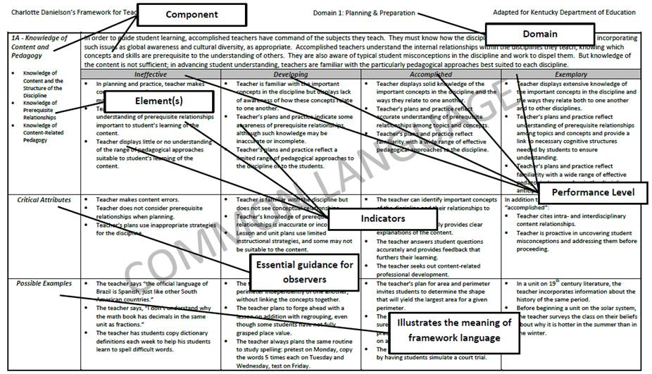
Notes:
Page two (2) of the Kentucky Framework for Teaching has this sample page highlighting the design of the document. It is important to understand this design because it is consistent across each of the five (5) domains.
Each page is clearly labeled with the Domain number and name. In our example it is Domain 1: Planning and Preparation.
The name of each component within the domain is listed on its own page along with a brief description. Here we see Component 1A: Knowledge of Content and Pedagogy. You will also note that a component might be further subdivided into elements. Our example has three elements that are part of Component 1A in Domain 1.
This might sound a bit confusing, but once you understand the design, you will see how it allows the user to easily access important information!
Next you see that there are four (4) performance levels identified as Ineffective, Developing, Accomplished, and Exemplary.
The indicators listed under each performance level are the “meat and potatoes” of the Framework for Teaching. These are examples of some of the characteristics of each performance level. They are NOT intended to be an exhaustive list nor a checklist. Their purpose is to guide the evaluator in making his or her best professional judgment of a teacher’s effectiveness based on the evidence.
And so the Domain, Component, Elements, Performance Levels, and Indicators comprise the official Framework for Teaching.
The two remaining rows, Critical Attributes and Possible Examples, serve to provide additional examples and guidance for the evaluator. However, they are not the teacher practices by which the performance levels are ultimately assigned.

Slide 38
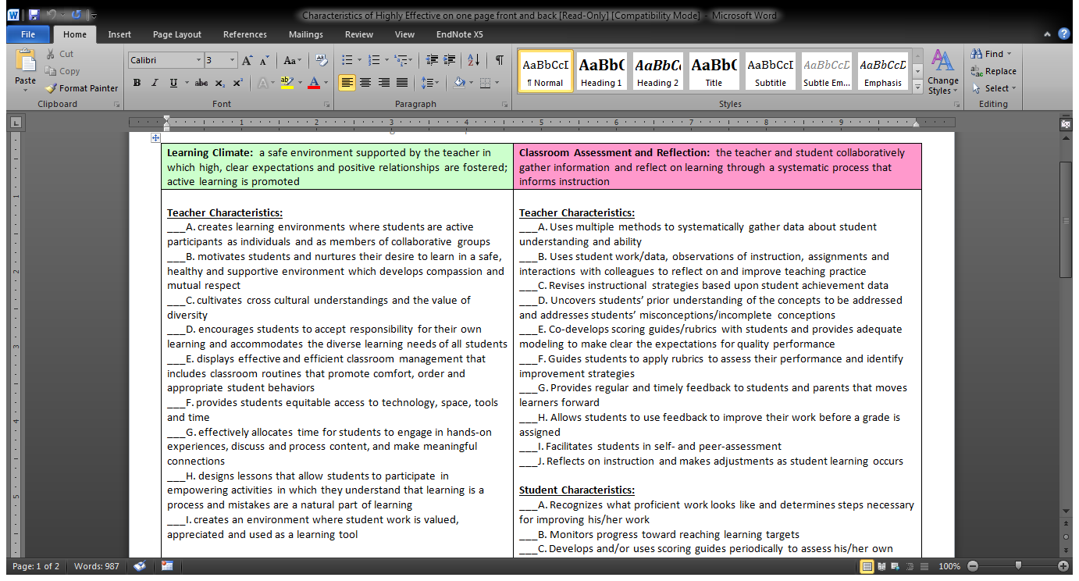
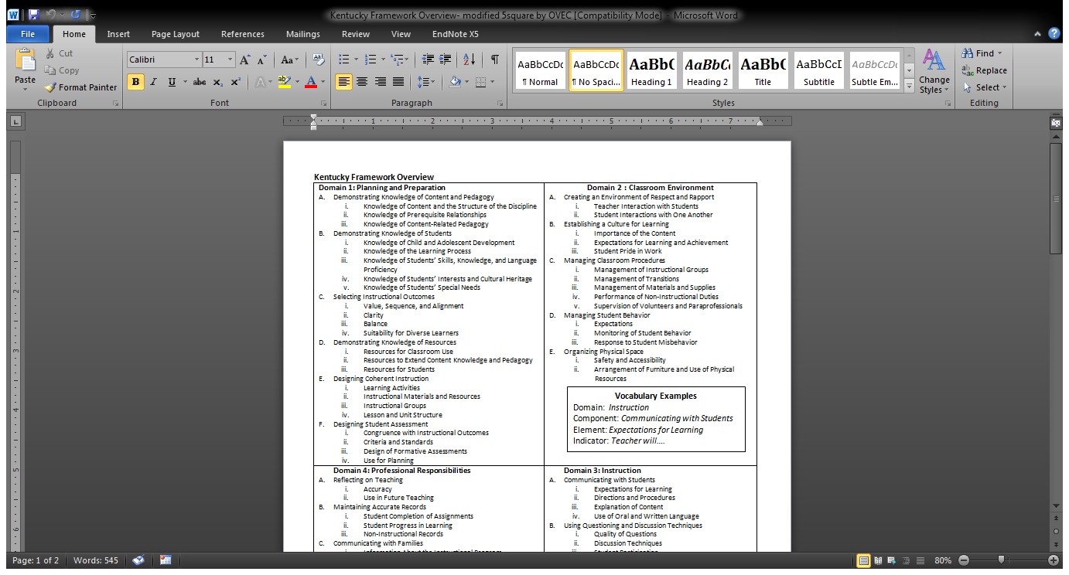
CHETL
FFT

Slide 39
Scaffolded Practice: I Do
2A
1B (iv)

Slide 40
Scaffolded Practice: We Do

Slide 41
Scaffolded Practice: You Do
Read your CHETL section
With your table, discuss what domains, components, and perhaps indicators of the FFT align with your section
Annotate your section accordingly
Post your group’s work

Slide 42
Debrief
Take your FFT one-pager with you on a gallery walk
Whole Group Discussion: Do the CHETL and PGES align well with one another? Do you have further questions about the connections between the two? Could you explain to a colleague?

Slide 43
“The method of science, as stodgy and grumpy as it may seem, is far more important than the findings of science.”
– Carl Sagan

Slide 44
Implementing the Science Standards
Science is a Verb
Marathon vs.100-yd dash
Start with implementing the Science and Engineering Practices into current curriculum

Slide 45
Dig in to the PRACTICES
Science and Engineering Practices are the processes, nature, and habits of mind for science and/or engineering.
Science Practices distinguish science from other ways of knowing.
When students actively engage in science practices, they deepen their understanding of core science ideas.
This vision of the core ideas, concepts, and practices provides the tools for students to engage in making sense of the natural and designed world.

Slide 46
Science & Engineering Practices: Group Task
Read your specific science and engineering practice. Feel free to annotate as you read the information taken directly from the Framework or share out your thinking as you partner read.
*Practice reading skills that resemble those that you ask your students to employ…
Notes:
Show of hands – familiar with practices?
Let’s get to know them a bit better…activity
Most are two pages in length. We will look at the attached progression sheets later…

Slide 47
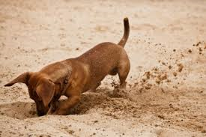
Digging In
Consider…
What are the key elements of this practice?
How would engaging in this practice support the learning of disciplinary core ideas?
How would use of this practice be different in an engineering context, as opposed to a science content?
How could you assess whether a student is proficient in carrying out this practice?

Slide 48
A-Z Summaries
Working as a table team, develop three summary sentences…
CRITERIA
Your summary sentences must begin with the alphabet letters provided for you in the center of your table.
Please chart your sentences.
Notes:
This is a Total Participation Technique - extension idea - increase higher order thinking by allowing a second sentence that states the importance of the summarized information to the content. (show book and cite page as source)

Slide 49
Next, review the Science and Engineering Practice Progression attached to your text.
Let’s Dig Deeper!
.
How does the progression for this practice build over the course of a student K-12 education?
Notes:
Picture notes provide a way for students to stop and process what they have learned- ensure comprehension of concepts. They are meant to accompany written notes – not replace them.

Slide 50
Quick Draw
Collaborate to create a visual model that represents the progression of your specific practice. Add your model to your chart.

Slide 51
Group Share
Notes:
Let’s learn from each other. Share out your alphabet summaries. Others will jot down the main points of the summary statement on their alphabet sheets- denoting which practice is being summarized.

Slide 52
Break Time
Please reconfigure your groups to represent grade level groupings. If you are the only representative from a grade level, create a grade band group (K-2, 3-5, MS and HS).

Slide 53
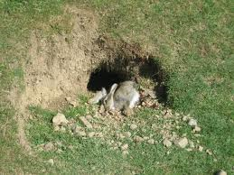
Dig Even Deeper
Life Science DCI progression from the NGSS Appendix E
Task: Reflect on your past instruction practices related to this specific disciplinary core idea. *List lessons and activities that you have incorporated in your instruction that align to this content on the left side of the provided chart.
Notes:
Hand out ready made charts

Slide 54
Science and Engineering Practices
1. Asking Questions (Science)and Defining Problems (Engineering)
2. Developing and Using Models
3. Planning and Carrying Out Investigations
4. Analyzing and Interpreting Data
5. Using Mathematics, Information and Computer Technology, and Computational Thinking
6.Constructing Explanations (Science) and Designing Solutions (Engineering)
7. Engaging in Argument from Evidence
8. Obtaining, Evaluating, and Communicating Information
Notes:
Consider the activities and lessons you charted. On the right hand side of the chart record the practice(s) by checking the column (s) that are integrated in the lessons – use practice # if you want.

Slide 55
Check for developmental appropriateness
1. Use the Science and Engineering Practices matrix in Appendix F. Are your activities aligned to the specific tasks at the corresponding grade band?
Reflection on your current instructional practices
2. Do your current instructional activities/lessons provide sufficient opportunities for all student to engage in the practices that are necessary for mastery of this DCI?
What are your noticings? NEXT STEPS?

Slide 56
So how ya doin”
So how
ya doin’?

Slide 57
Innovation Configuration Maps
Introduced at ISLN last year, reviewed last week
Developed by Kentucky educators
A planning tool, not a rubric
Designed for district planning
Roadmap for innovation and leadership

Slide 60
Working with IC Maps
Working with your district team, discuss where you think your district is on the sample pages in your materials
Discuss with other districts, if time allows

Slide 61
Meeting dates
November 22*
January 30
February 27
March 27

Slide 62
Follow up
Read Chapters 1-3 in the Classroom Assessment for Student Learning (CASL) book
Have a conversation with your district leadership team about how your district is using the Innovation Configuration Maps
Bring an instructional unit you are currently teaching to review through the lens of the NGSS
Be on the lookout for a scheduling email

